Slide 1
Creating GUI program using java.awt

Slide 2
Java.awt Package
  Awt allows java developers to quickly build java applets and application using a group of prebuilt user interface components.
  AWT Package
    JDK consists of a package called Abstract Window Toolkit (AWT).
    AWT is an Application Programming Interface (API) that is responsible for building the Graphical User Interface (GUI) in Java.
    The API of the AWT package consists of a collection of classes and methods that enables you to design and manage the Graphical User Interface (GUI) applications.
    The AWT package supports applets, which help in creating containers, such as frames or panels that run in the GUI environment.

Slide 3
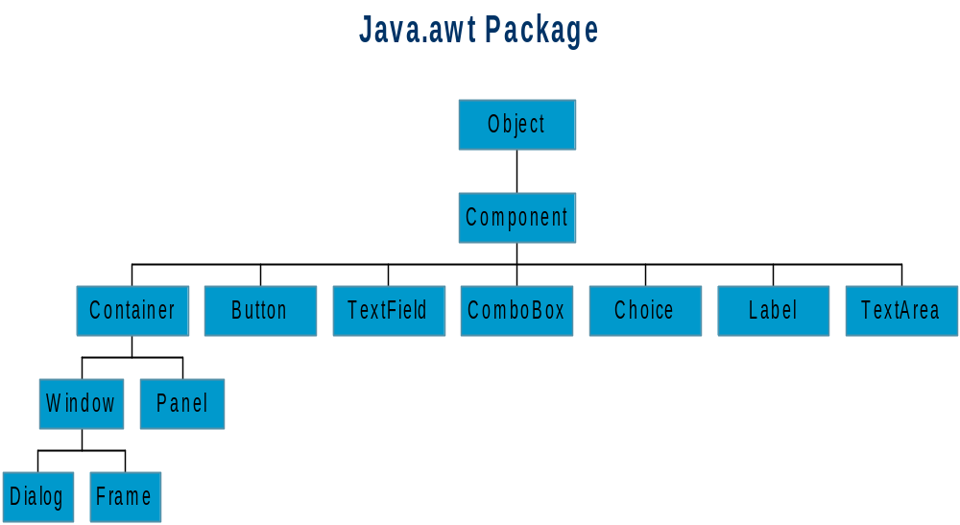

Slide 4
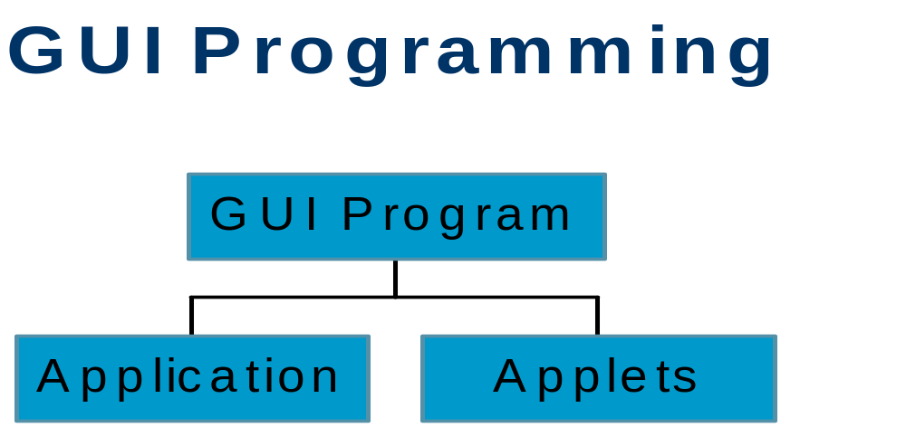

Slide 5
Application vs. Applets
  For applets it needs lots of time to download it
  Application is more secure than applets
  Application can be GUI as well as CUI but applet can only be GUI.
  Application requires main method but applet not.

Slide 6
Creating application
  Application can be created with the help of Frame class.

Slide 7
  Using Various AWT Components (Contd.)
      TextArea: Used to accept text input from an end user, but it enables you to type text in multiple lines. An instance of the TextArea class is used to create a text area.
      Button: Used for handling events. Java provides the Button class to create AWT button components.
      List: Is a scrollable list of text items that enables you to select either one item or multiple items. You create a list using the List class in Java.
      CheckBox: Exist in dual state, checked and unchecked. You can change the state of a check box by clicking the check box. You create a check box using the CheckBox class.

Slide 8
      Choice: Used to create combination boxes that are also known as drop-down menus using the Choice class in Java. You create a drop-down menu using the Choice class that enables you to select a single item from the menu.
      Labels: Used for displaying a single line of text in a container. You create a label using the Label class.
      CheckboxGroup:The CheckboxGroup class is used to group together a set of Checkbox buttons.

Slide 10
Structure of simple Application
import java.awt.*;
public class appDemo extends Frame
{
public appDemo()
{
}
public static void main(String arg[])
{
}
}

Slide 11
Creating Button
  Example:
import java.awt.*;
Button b1=new Button(“My Button”);

Slide 12
Creating TextField
  A box where user can enter value.
  Can be edited.
  Value can be retrieved using getText() method.
  Text can be set using setText()
TextField t1=new TextField(20);

Slide 13
Creating TextArea
  TextArea is used when u want to accept multiple lines
TextArea ta=new TextArea(10,10)

Slide 14
Creating Choice
  Choice provides a drop down List of items.
  .
Choice city=new Choice()
city.addItem(“Delhi”)
city.addItem(“Mumbai”);
city.addItem(“Kokatta”);

Slide 15
Label: Label provides a static text which can be set using constructor or setLabel method.
Label lname=new Label(“Name”);

Slide 16
CheckBox
  Used to allow user to select one or more items.
  Always has Label
  Program often needs to react to user selection(s)
Checkbox c1=new Checkbox(“Music”);
Checkbox c2=new Checkbox(“Movies);
add(c1);
add(c2);

Slide 17
RadioButtons
  A group of checkboxes where only one item can be select at a time.
  Implement using CheckboxGroup class.
  Items are declared initially selected or not selected.
CheckboxGroup gender;
Checkbox maleCheck=new Checkbox(“Male”,gender,true);
Checkbox FemaleCheck=new Checkbox(“Male”,gender,true);

Slide 18
List Box
  List(int rows, boolean multiselected)
    Creates the list box with specified no of rows.
    Depending on the number of items ScrollBar will be automatically created.
    Second argument specified whether the item is multiselected or not.

Slide 19
Example
List Methods
  add()
  isMultipleMode()
  remove()
  getSelectedIndex()
List list1=new List();
list1.add(“Vanila”);
list1.add(“Strawbery”);
list1.add(“Chocolate”);
add(list1);

Slide 20
Problem Statement
  ABC. Corporation wants to create an application where it will accept details about its customer. The form should include following details
    Name of Customer
    Customer Address
    Customer Phone
    Customer Hobbies
    Gender
    Salary Details of Customer
    The form should also have buttons for submitting details and cancel the details.
    It should also have one menu where it will be having item called New Customer and Delete Customer.

Slide 21
Review
  Hierarchy in java.awt package
  Components in awt package

Slide 22
Creating Applets in Java

Slide 23
Applets
  An applet is a special program that browser enabled with java technology can download and use it.
  An applet must be subclass of Applet class which provides the standard interface between browser and applet.

Slide 24
Life Cycle of Applet
init
start
stop
destroy

Slide 25
Life Cycle
  init
    To initialize the applet each time it's loaded (or reloaded).
  start
    To start the applet's execution, such as when the applet's loaded or when the user revisits a page that contains the applet.
  stop
    To stop the applet's execution, such as when the user leaves the applet's page or quits the browser.
  destroy
    To perform a final cleanup in preparation for unloading.
    Note: Not every applet needs to load every method.

Slide 26
More about Life Cycle
  init
    The init method is useful for one-time initialization that doesn't take very long. In general, the init method should contain the code that you would normally put into a constructor.
  start
    Every applet that does something after initialization (except in direct response to user actions) must override the start method. The start method either performs the applet's work or (more likely) starts up one or more threads to perform the work.

Slide 27
stop
  Most applets that override start should also override the stop method. The stop method should suspend the applet's execution, so that it doesn't take up system resources when the user isn't viewing the applet's page. For example, an applet that displays animation should stop trying to draw the animation when the user isn't looking at it.
destroy
  Many applets don't need to override the destroy method, since their stop method (which is called before destroy) does everything necessary to shut down the applet's execution. However, destroy is available for applets that need to release additional resources.

Slide 28
JApplet
  Any applet that uses swing components must be a subclass of JApplet.
  Any applet that uses swing components must be a subclass of JApplet.
Instead of creating the GUI component in the constructor (for applications), do all the GUI construction in the init() method (for applets).

Slide 29
How browser runs an applet
  You include applets in HTML pages using the <APPLET> tag. When a browser user visits a page that contains an applet, here's what happens:
    The browser finds the class file for the applet's Applet subclass. The location of the class file is specified with the CODE and CODEBASE attributes of the <APPLET> tag.
    The browser brings the class file(s) over the network to the user's computer.
    The browser creates an instance of the Applet subclass. When we refer to an applet, we're generally referring to this instance.
    The browser calls the applet's init method. This method performs any one-time initialization that is required.
    The browser calls the applet's start method. This method often starts a thread to perform the applet's duties.

Slide 30
Review
  Introduction to applet
  Life cycle of applet
  Writing an Applet

